Slide 1

SOUTHWICK TOLLAND GRANVILLE REGIONAL SCHOOL DISTRICT
CONTRACT AND POLICIES

Slide 2
Article IV- temporary leaves of absence
Fast facts (full article is found on page 7 of the contract)
Paid temporary leaves of absence defined in numbers 2-7 below will be in addition to any sick leave accumulated by the teacher and must be taken in half-day or full-day increments.
A maximum of three (3) days of absence will be allowed for religious observances during the school year, where the tenets of the religion require the person to refrain from work or attend a religious ceremony which conflicts with the employee’s work hours.
3 personal days may be taken each school year. Personal day requests must be submitted in writing to the Principal at least two (2) workdays before the day is taken, and prior approval to take a personal day must be obtained from the Superintendent. Need to be submitted to building principal.
During the month of May, personal days may not be taken on Mondays or Fridays. Teachers can request a meeting with the Superintendent in order to discuss whether the Superintendent will grant a waiver due to exceptional circumstances and/or life events. Any such waiver is at the sole discretion of the Superintendent. Personal days shall not be used to extend a vacation or a holiday.

Slide 3
Leaves of Absence continued
Longevity Day - In addition, there will be one (1) longevity day for teachers with 15 or more years of service in the district
Any unused business/legal, personal, or longevity day will be added to the teacher’s sick leave accumulation.
A maximum of twenty (20) days in total may be taken annually for the following:
One to five (5) calendar days’ leave of absence may be taken at one time in the event of death in the immediate family.
Any other situations will be considered at the discretion of the Superintendent of Schools.
Bereavement Day. No more than five (5) teachers may be absent from each building on any given day.

Slide 4
Sick Leave
Fifteen (15) days of sick leave will be credited each school year (pro-rated at one and one half (1 1/2) days per school month), and one hundred eighty-four (184) days of sick leave may be accumulated. Effective August 25, 2020, teachers may use up to fifteen (15) of their fifteen (15) annual days of sick leave per school year for the purpose of caring for a parent, child, spouse, grandparent, sibling, or other family member or significant other living in the same domicile. In addition, if the leave is covered by an approved FMLA application to care for an immediate family member, then the employee may use an additional ten (10) days of their accumulated sick leave.
Sick leave exceeding accumulated leave will be deducted from the teacher’s pay at the rate of 1/184 of the annual salary per day.
The Superintendent of Schools may request a doctor’s certificate for absence due to illness of the employee, family member or significant other as listed in Section 1 above after three (3) consecutive days or on days before or after a holiday or vacation, or in cases where abuse is suspected .
The leave benefits in this section will be prorated based upon the employee’s FTE and/or if the employee was hired after the commencement of the work year.

Slide 5
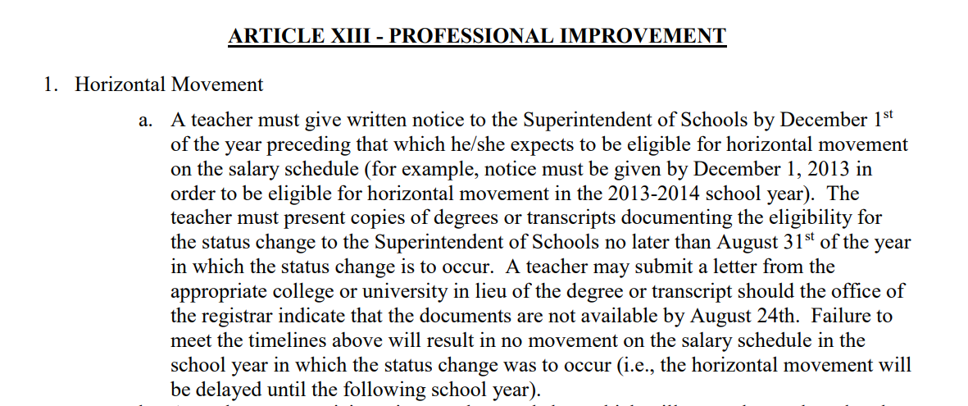

Slide 6
Article XIII Professional Improvement
Horizontal Movement
  A teacher must give written notice to the Superintendent of Schools by December 1st of the year preceding that which he/she expects to be eligible for horizontal movement on the salary schedule (for example, notice must be given by December 1, 2013 in order to be eligible for horizontal movement in the 2013-2014 school year) along with supporting documentation as described in this article in the contract.
  A teacher may participate in a teacher workshop which will strengthen or broaden the teacher's background. If the workshop occurs during regular work hours, earned PDP’s for this kind of activity may be used for license renewal. If the workshop occurs outside of regular work hours, then the teacher may seek prior approval for up to three (3) credit hours toward salary movement.
  A teacher may participate in external conferences.
  Beginning September 1, 1998, the formula for converting in-service hours and activity clock hours is thirty (30) hours of previously approved in-service equals one college credit for the purpose of salary advancement. Effective September 1, 1990, three (3) in-service credits equal one college credit for purposes of horizontal movement on the wage scale.

Slide 7

Professional Improvement cont.
Changes in salary column.
  Salary credits will become effective the first workday of the school year. Official notification for all levels of training shall be in the form of an official transcript and/or certified form from the school district, college or university.
  Degrees must be awarded, or course work completed no later than August 24 of the year in which the status change occurs.
  The teacher must present copies of degrees or transcripts documenting the eligibility for the status change no later than thirty (30) days after completing the last requirement or course. A teacher may submit a letter from the appropriate college or university official in lieu of the degree or transcript should the office of the registrar indicate that the documents are not available within the time limits.

Slide 8

Professional Improvement cont.
Effective August 25, 2019, the School Committee will reimburse each teacher for the cost of one (1) three (3) credit graduate course each contract year, at an approved institution, successfully completed with a grade of B or better, in an amount up to One Thousand and Fifty Dollars ($1,050) (note: if the course is less than three (3) credits, then the amount will be prorated. Effective August 25, 2020, the total amount available for the bargaining unit for course reimbursement shall be a maximum of Twenty Thousand Dollars ($20,000). Reimbursement shall be made on a first-come first-served basis until the maximum bargaining unit amount is reached at which point no further reimbursements shall be made. Teachers will be notified when submitting for the course if monies are still available, and if the course can be reimbursed.
The number of District-approved PDP’s that the teachers have earned as of the conclusion of the preceding school year shall be available online. (frontline)

Slide 9
ARTICLE XXV - WORK DAY
It is expected: That there will be the same seven (7) hour continuous workday for all teachers located in the same building, except where otherwise provided below. Nurses shall work seven (7) hours each day, including a ½ hour paid lunch.
School Hours
Southwick Regional School
7:30-2:30
Powder Mill Middle School
8:00-3:00
Woodland Elementary School 8:40-3:40
The times above will not be adjusted by more than five minutes.

Slide 10
Workday Continued
There will be two (2) evening Parent/Teacher conferences at all schools per year. There shall be a three (3) hour early release time on the last school day of the two-week period during which conferences are held in the three buildings.
There will be one (1) faculty meeting of one (1) hour maximum after school each month. This does not preclude additional meetings during the seven (7) hour teacher day when necessary.
That teachers may leave the last school day of each week as soon after closing as possible provided his/her students have been cared for, plans for the next day are completed and details are in proper order. By the end of each week, teachers will have prepared lesson plans for the following week.
Teachers may mutually agree with principals, subject to the approval of the superintendent, to adjust reporting and leaving times to accommodate special supervision, meetings, or other special demands on a teacher’s time.

Slide 11
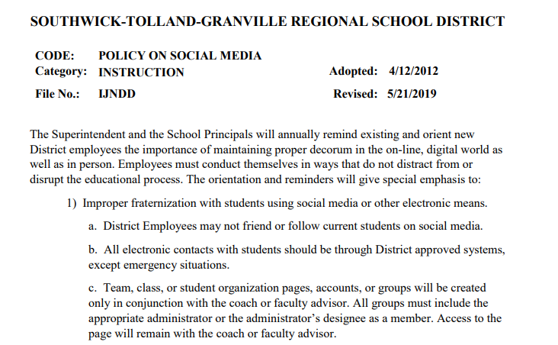

Slide 12
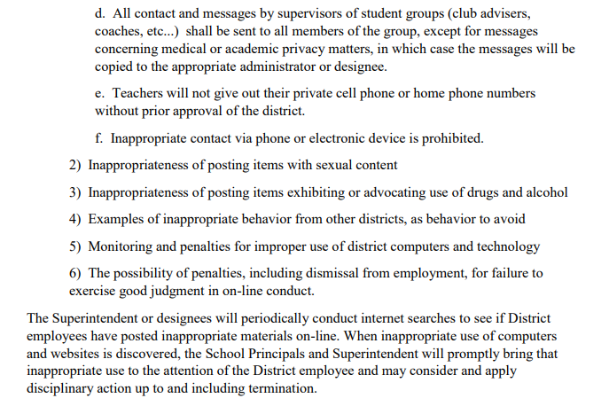

Slide 13
By- Laws- representation in meetings
Article XVII-Member Rights
1. All members shall be entitled to representation at meetings, either formal or informal, in which their position or professionalism may be threatened or questioned by a supervisor or administrator.
2. In the event that two or more members are involved in a conflict with each other, in the context of the circumstances outlined in section one of this article, each member has the right to representation from the Association. In the event that one such member requests a representative, each member will be entitled to a representative from his/her unit.
3. It is understood that any member has the right to refuse representation as outlined in sections one (1) and two (2).

Slide 14

Southwick Educators Association
President- Carolyn Roberts, District Psychologist (SRS)
Vice President- Rachel Knowles, History Teacher (SRS)
Stephanie Niedzela, Math Teacher (SRS)
Shannon Naumowicz, 5th Grade Teacher (PMS)
Monthly meeting date with zoom link will be posted on SEA website- https://sea.massteacher.org/

